Slide 1
Disorders & Treatment
Randall C. O’Reilly

Slide 2

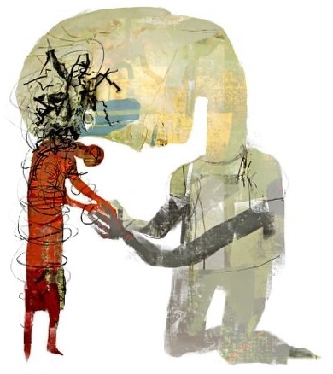
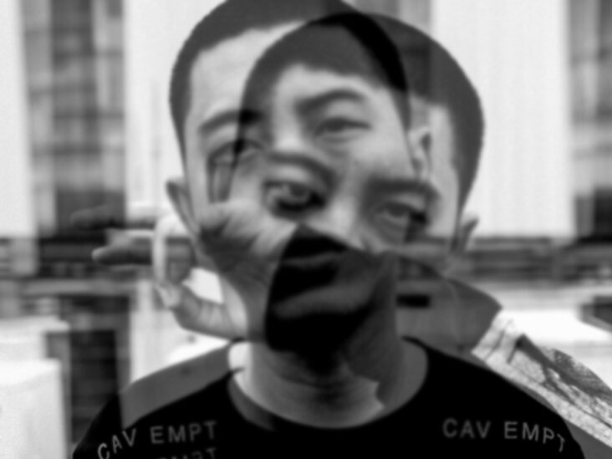
Loss of Control

Slide 3
20% suffer at any time 50% lifetime risk

Slide 4
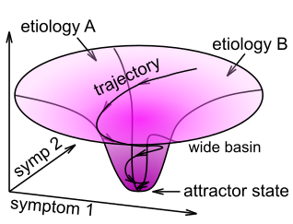
Comorbidity: Network Attractor
If you have anxiety, likely also depression
Any disorder => impaired self efficacy / control / esteem
All roads lead to vicious cycle: disengagement, not trying, more depression, etc..

Slide 5
Virtuous Cycles Too!
Therapy can intervene in this vicious cycle, start bending toward a virtuous one

Slide 6

Therapy is Safe Social Bond Rebuilds Self-Efficacy, Control

Slide 7
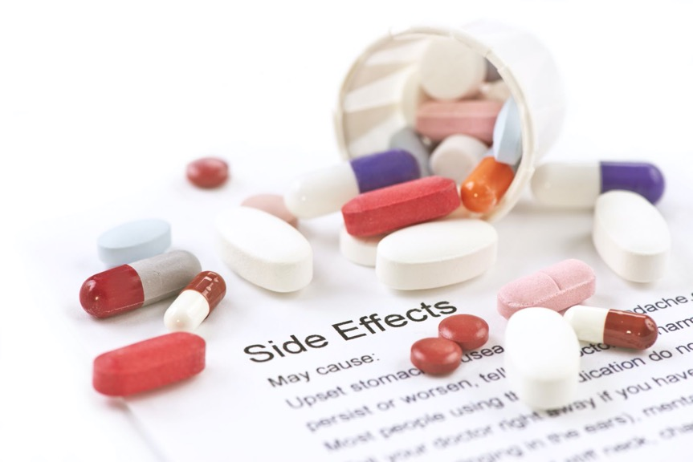
Therapy (CBT) >= SSRI!
For most anxiety, depression cases.
Has no side effects!
But is expensive!

Slide 8
Clinical Professionals, DSM-5
Psychiatrist: MD, prescribes drugs
Clinical Psychologist: PhD / MA, Certification, does therapy
Social worker: MA, clinical training
Neurologist: MD works on neural diseases (Parkinson’s, epilepsy, Alzheimer’s)
DSM-5: Diagnostic and Statistical Manual of Mental Disorders (American Psychiatric Assoc)

Slide 9
Disease Model
Standard medical paradigm:
- Clear biological cause (etiology)
- Direct biological treatment, fixes problem to extent possible
- Parkinson’s, epilepsy, Alzheimer’s
Does this apply to everything – just a matter of time to find biological treatment –
or are some disorders qualitatively different?

Slide 10
Attractor = “Psychological” not Bio
We are active agents in our own brains!
We are in control, and disorders are challenge to control.
Treatment is to restore control.
Control is not biological!
Involvement of the self/control increases stigma, harder for insurance to cover, etc – is it their own fault?
Many afflicted.. maybe pervasive therapy possible?

Slide 11
Definition of a Disorder
Previously:
a disorder must cause distress and / or disability (impairment in one or more important areas of functioning).
Now (DSM-5):
A mental disorder is a syndrome characterized by clinically significant disturbance in an individual’s cognition, emotion regulation, or behavior that reflects a dysfunction in the psychological, biological, or developmental processes underlying mental functioning. Mental disorders are usually associated with significant distress in social, occupational, or other important activities.
Just a bit more specific..

Slide 12
Definition of a Disorder
Obviously, something must be “wrong”
But that is not sufficient – can be a “happy nutter” that people generally regard as strange..
Much harder to be locked up against will
(also much harder to get needed treatment..)
personal distress is key!

Slide 13
Definition of a Disorder
Exclusions:
An expectable or culturally approved response to a common stressor or loss, such as the death of a loved one, is not a mental disorder. Socially deviant behavior (e.g., political, religious, or sexual) and conflicts that are primarily between the individual and society are not mental disorders unless the deviance or conflict results from a dysfunction in the individual, as described above.

Slide 14
DSM-5 Categories, Prevalence Order
Anxiety disorders (GAD, Panic, Phobia)
Depressive disorders (MDD)
Substance Use Disorders (dependence)
Bipolar Disorder
Eating disorders (Anorexia, Bulimia)
Schizophrenia
Obsessive-Compulsive disorders (OCD)
Trauma and Stressor-Related disorders (PTSD)

Slide 15
DSM-5 Developmental Disorders
ADHD (Attention Deficit, Hyperactivity Disorder), 5% prevalence
Autism Spectrum Disorder

Slide 16
DSM-5 Personality Disorders
Similar to other disorders in many cases
But: trait-like, present consistently from earlier age, focused more on social interactions – extreme personalities.
Schizoid, schizotypal: social anxiety, withdrawal
Antisocial, borderline, histrionic, narcissistic: high neuroticism, low agreeableness personality factors
Avoidant, dependent, obsessive-compulsive..

Slide 17
Personality Disorders in OCEAN
Extreme factors:
Antisocial: ---agreeableness?
Avoidant: +++neuroticism, ---extroversion
Borderline: +++neurotic, ---agreeable, ---conscientious
Paranoid: +++neuroticism
Obsessive-compulsive PD: +++conscientious
Schizoid: ---extroversion
Narcissistic: ---agreeable

Slide 18
Are Categories Useful?
Current trend is away from categories
Comorbidity rates are very high
Anxiety <-> Depression @ 50%
Biological differences are not very specific
Continuum of functionality – dimension is important, not the specific value..
But categories simplify, have pragmatic value
Many benefits to being definitively “sick” or not (insurance, treatment, acceptance, etc)
also drawbacks (one-size-fits-all treatment, stigma)

Slide 19
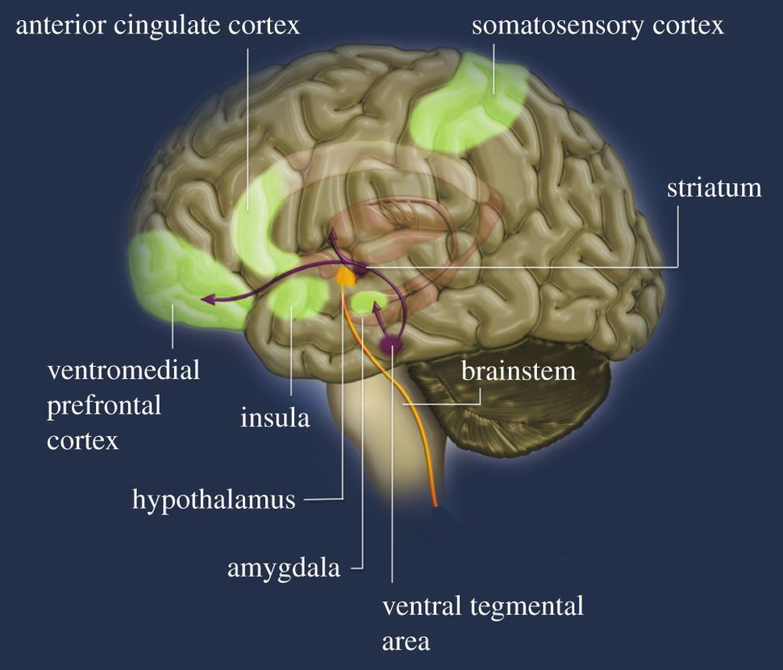
Same Major Brain Areas Involved in Most Disorders
Substance-use, addiction
Schizophrenia, Psychotic
Depression, Bipolar
Anxiety
OCD
Feeding, eating
PTSD?
This is the emotional nervous system

Slide 20
Anxiety
Generalized anxiety disorder (GAD)
Excessive, difficult to control anxiety and worry
One or more of: restlessness, on edge; difficulty concentrating, going blank; irritability; muscle tension
Panic attack: overwhelming terror (~10 min)
Panic disorder: fear of having attacks -> agorophobia (avoid public, confined places)
vs. Specific phobias (snakes etc)

Slide 21
Depression Symptoms (DSM-5) (5 or more, must include 1st 2)
Depressed mood
Loss of interest or pleasure
Weight, appetite change
Disturbed sleep
Lethargy or agitation; fatigue or loss of energy
Feelings of worthlessness, guilt
Difficulty concentrating, decision making
Recurrent thoughts of death, suicide

Slide 22
Depression = Loss of Control
Vicious cycle of: negative affect -> inability to select goals -> negative affect -> .. (hopelessness)
Everything has high cost, low gain
Beck negative cognitive triad: bad thoughts about self, the world, and the future
anhedonia = inability to experience pleasure

Slide 23
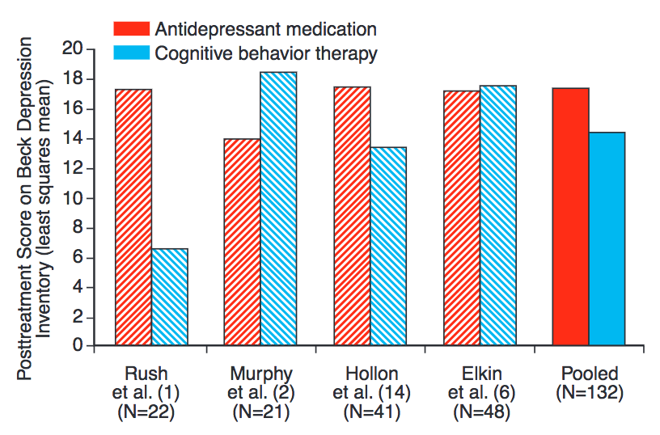
MBCT = Mindfulness-based Cognitive Therapy
Dimidjian et al, 2014

Slide 24
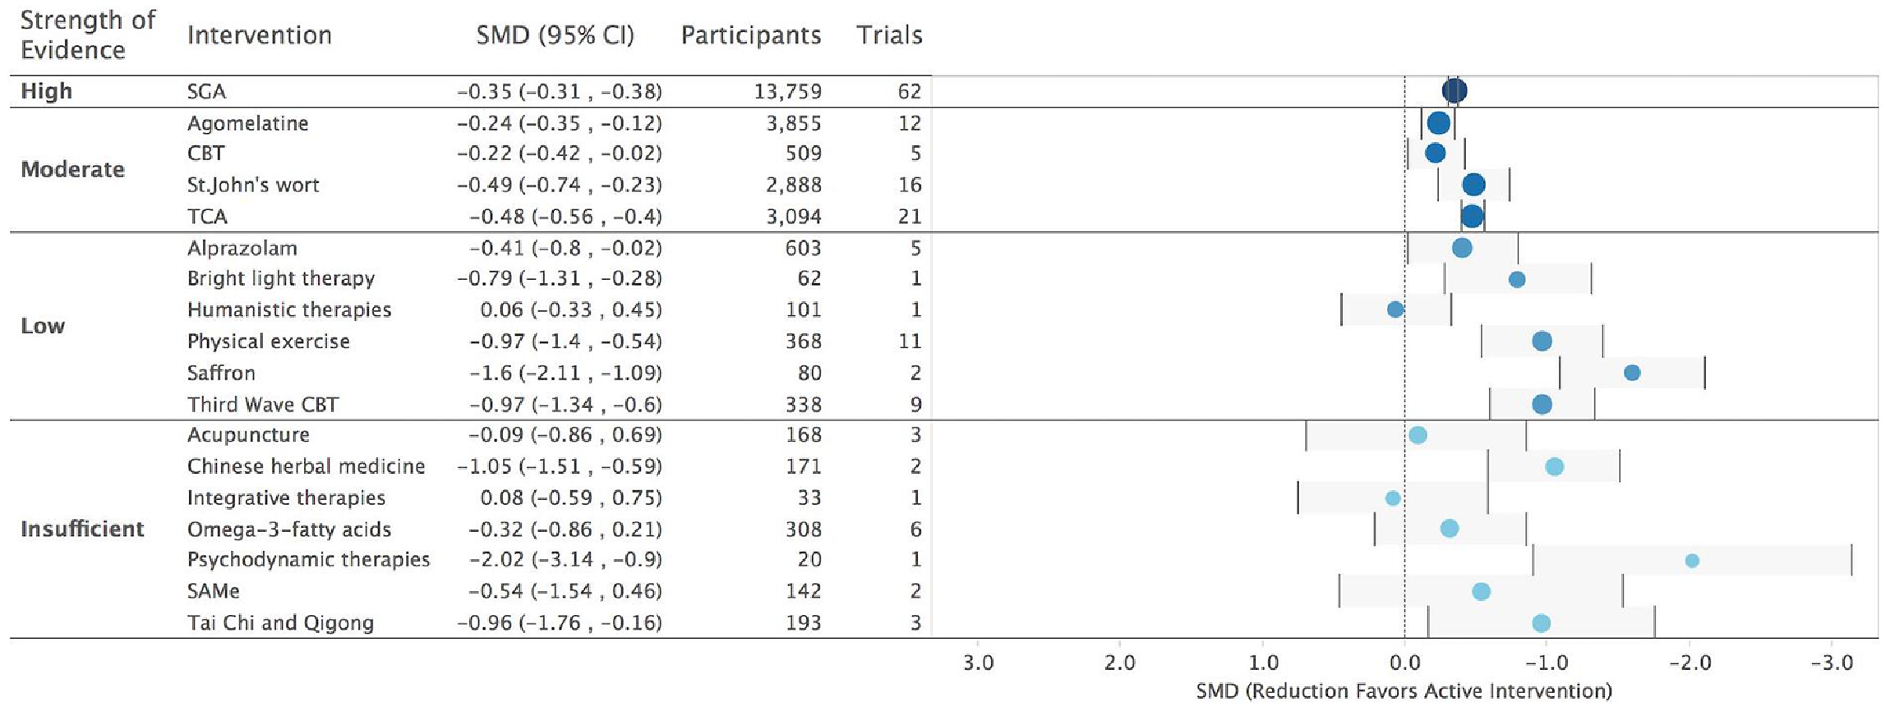
Treatment Efficacy (Gartlehner et al, 2017)

Slide 25
Serotonin is VERY Complex
SSRI are broadly effective, but not a magic pill..
Many different 5HT pathways, receptors, each with different, opposing effects
“Happy” 5HT pathway: interfascicular raphe (DRI)
“Sad” 5HT pathway: caudal raphe?
Many others..!
Chemical imbalance vs. chemical intervention / jumpstart?

Slide 26
Substance Use Disorders
Withdrawal: unpleasant feelings from lack of use
Craving: overpowering feeling of wanting
Tolerance: progressive need for more to get same effect
USA Drug + Alcohol deaths: 100,000
Tobacco: 480,000
Relapse rate: 40-60%

Slide 27
Bipolar
Manic – depressive phases
Hypomania = lower-level of mania that can produce highly creative work
Many famous creative people:
Kanye West, Carrie Fisher, Mel Gibson, Demi Lovato, Kurt Cobain, Frank Sinatra, Vivien Leigh, and Winston Churchill

Slide 28
Eating Disorders: Control
Anorexia nervosa: extreme form of conscientiousness, comorbid with OCD
Bulimia nervosa: binging & purging (loss and restoration of control)

Slide 29
Schizophrenia
Positive symptoms: not present in normals: hallucinations
Negative symptoms: reduced functionality: depression, social withdrawal
Major “split” is between individual and society: pathway to first episode is through social isolation

Slide 30
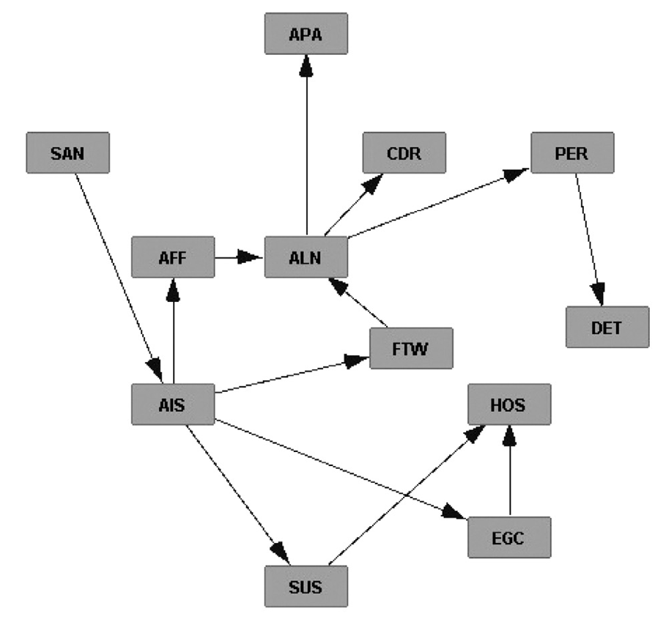
Pathways of Development (van Kampen, 2014)
SAN: Social Anxiety
AIS: Active Isolation
EGC: Ecocentrism
AFF: Affective Flattening
SUS: Suspiciousness
HOS: Hostility
ALN: Alienation
APA: Apathy
CDR: Cognitive Derailment
FTW: Fantasy World
PER: Perceptual Abberations
DET: Delusional Thinking

Slide 31
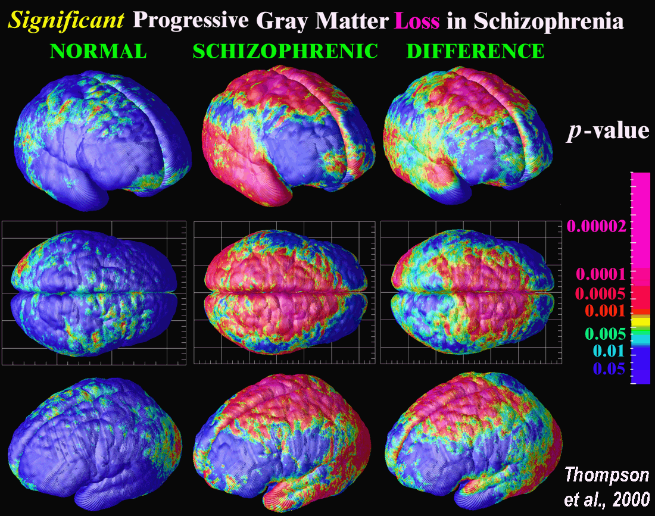
Schizophrenic Brain: Widespread Diffs

Slide 32
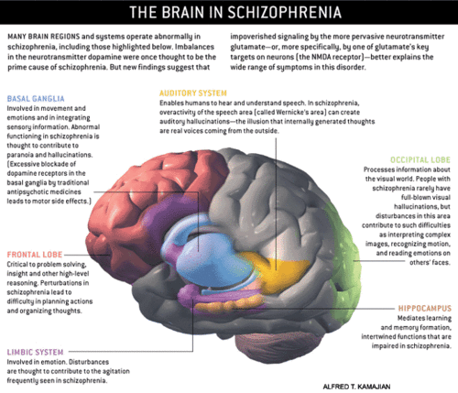
Schizophrenic Brain: Widespread Diffs
MIA model:
ACC, PFC effects
Vijay Mittal: Basal Ganglia impairments before onset of Scz

Slide 33
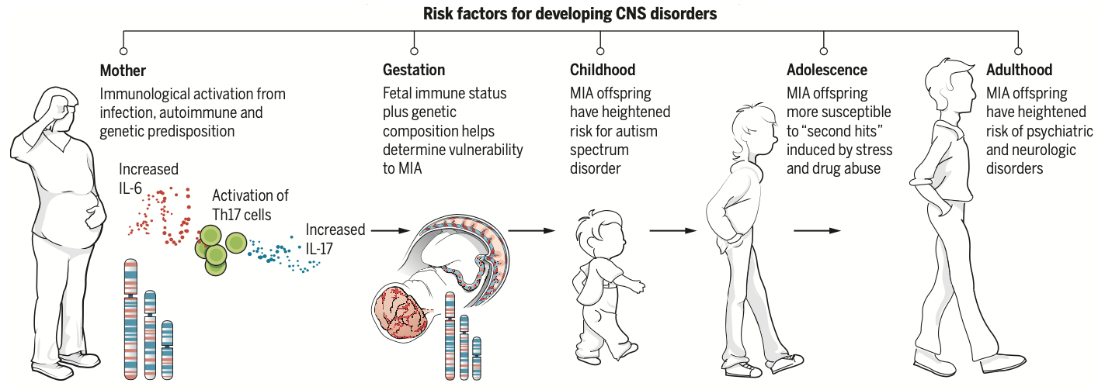
Maternal Immune Activation (Meyer, 2014; Estes & McAllister, 2016)

Slide 34
PTSD
Re-experiencing traumatic event
Negative changes in mood and cognition: detachment, loss of interest..
Changes in physiological arousal levels and reactivity: sleep, irritability, reckless, self-destructive..
1.3% develop in any given year. 6% of 9/11 terror attacks suffered from PTSD. Resilience!

Slide 35
OCD
Obsessive = repeated thoughts
Compulsive = repeated behaviors
Insatiable goals constantly re-selected, driving habitual motor plans: incompleteness
Harm avoidance: when is avoiding over?
Subtypes: symmetry, cleaning, forbidden thoughts, hoarding

Slide 36
Developmental: ADHD
Neurodevelopmental: in a different category from other disorders
Attention Deficit: inability to focus attention over extended time periods
Hyperactivity: constant movement, fidgeting
Impulsivity: hasty decision making, without regard to consequences
Treated with stimulants including Ritalin

Slide 37
ADHD and Motivation
Prevalent hypothesis: executive (PFC) dysfunction – however, not reliable (Willcutt et al)
Volkow et al (2011): “These findings provide evidence that disruption of the dopamine reward pathway is associated with motivation deficits in ADHD adults, which may contribute to attention deficits and supports the use of therapeutic interventions to enhance motivation in ADHD.”

Slide 38
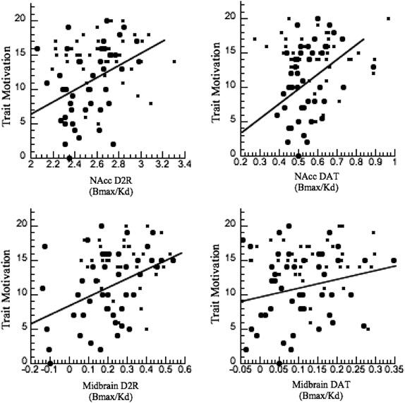
Volkow et al, 2011
Relationship between ventral striatum (basal ganglia) dopamine factors and motivation levels for individual subjects.
D2R = dopamine D2 receptor
DAT = dopamine transporter (re-uptake)

Slide 39
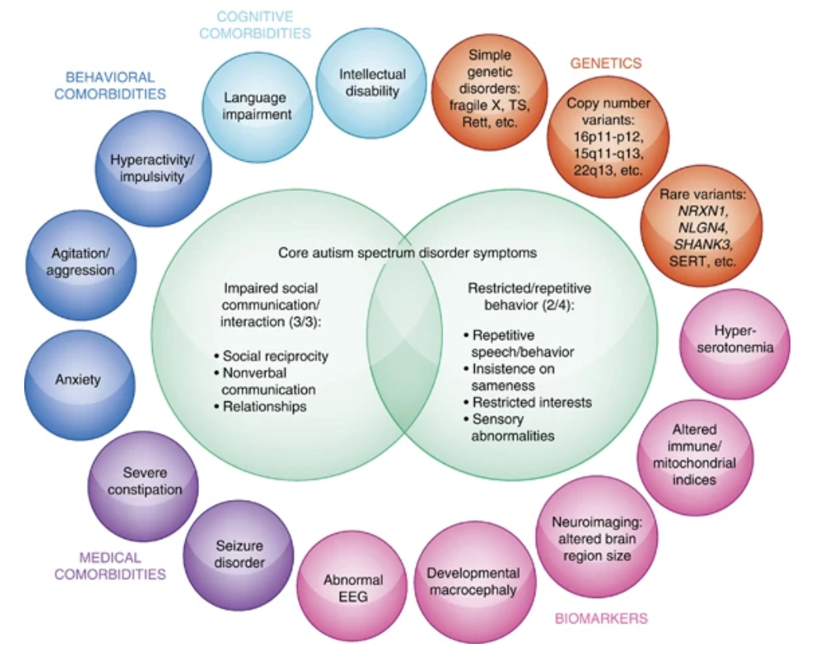
Autism Spectrum
Many simple theories for a complex, heterogeneous disorder
* Theory of mind
* Extreme male
Savant is very rare: over 50% have self-harm behavior
Etiology connected to schizophrenia (MIA), but maybe more severe, so manifests earlier?

Slide 40
DSM Definition of PD
Personality disorder must have at least 2 impairments:
Identity: stable self-esteem, boundaries, etc
Self-direction: ability to pursue goals
Empathy
Intimacy

Slide 41
Borderline Personality Disorder
BPD is particularly dangerous (self & other harm):
Impulsive, moody, frightened of abandonment, unstable sense of self, emptiness, worthlessness, stormy relationships

Slide 42
Diathesis-Stress Model
Diathesis: genetic vulnerability ~50% heritability
Stress: experience that triggers latent genetic predisposition
Mindfulness-based therapy attempts to reduce stress response to adverse experiences, promote acceptance, understanding.

Slide 43
Triple Vulnerability Theory (Barlow)
Generalized Biological Vulnerability (genetic)
Generalized Psychological Vulnerability
General beliefs about the world (dangerous, etc)
Specific Psychological Vulnerability
Specific learned beliefs / situations (embarrassment is very bad)
= Stress -> Social Anxiety Disorder

Slide 44
Therapy Definition
Psychotherapy is a unique form of relationship:
Focus entirely on client’s needs and problems
Therapist is paid
Therapy takes place in structured setting
Each meeting is time-limited (e.g., 50min)
The relationship is expected to terminate

Slide 45
Therapy is Safe Social Bond Rebuilds Self-Efficacy, Control

Slide 46
Forms of Therapy
Current, Empirically Supported Therapy (EST):
Cognitive-Behavior Therapy (CBT): change thoughts and behaviors (GAD, Panic, Depression)
Mindfulness-based CT (MBCT): + acceptance
Behavior Therapy (BT): conditioning (Depression)
Exposure Therapy (OCD, phobias)
(also Group, Family, Couple Therapy)
Integrative: most common, tailor to client
Old: Psychoanalysis, Psychodynamic Therapy, Client-Centered Therapy, REBT

Slide 47
Science Works!
Behavioral Therapy = Behaviorism Theory
Cognitive Therapy = Cognitive Theory
Mindfulness = Buddhist Theory ☺

Slide 48
Cognitive (Behavior) Therapy
Goal: change negative beliefs, automatic thoughts (negative cognitive triad, Beck) *and behaviors*
Method: get client to question beliefs, confront negative thoughts with positive facts..
Challenges: Many ways of focusing on negative: Overgeneralization; Discounting positives; Catastrophizing; Mind-reading; Magnifying; Filtering

Slide 49
Behaviorism and Exposure
Behavior Therapy: Use operant, classical conditioning to shape positive patterns of behavior (prizes, token economy, contingency mgmt)
Exposure Therapy: Extinguish negative associations through careful extinction training: systematic desensitization (don’t activate “US”)
.. or flooding (wear it down!)

Slide 50
Therapy Works!
Average client is better than 80% of non-clients!
Randomized Controlled Trials: gold standard (random assignment -> causal not just correlation)
Clinical Significance: need more than a statistical effect – need an actual “cure” (e.g., couple therapy example: does couple stay together??) – Not widely achieved!!

Slide 51
Why All Therapies Work (everyone’s a winner! = dodo bird)
Theraputic alliance; Therapist allegiance and competence.
Why do these factors make people feel better?
Hope, confidence, positive emotions, willingness to commit effort..
In other words, therapy imparts self-efficacy and reboots goal-driven cognitive system!
CCC = Control

Slide 52
Bottom line
It takes serious work to overcome strength of negative emotional systems:
Easy to be overcome with defeatist, negative thoughts, worries, anxieties, etc
Sometimes you need some help! Someone who can talk you through it, get you pointed in a new direction, etc..
First step is always recognition and acceptance, and understanding that this is just how your brain works, and you just need to work at it to overcome..

Slide 53
Pharmacotherapy
No more effective than “placebo” for most people
Massive conspiracy marketing from drug companies, pushing a “miracle cure” for shiny happy people!
Major side effects and risks, including extreme violence, suicide in some cases..

